Slide 1

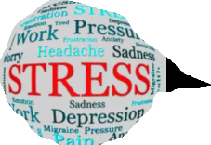
Presented By: Ritesh Pandey Swati Singh
STRESS DETECTION USING CNN
Guided By:
Mr. Rajan Kakkar

Slide 2
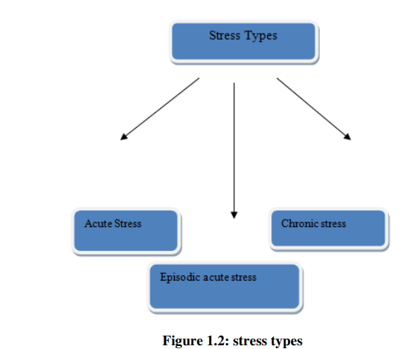
Stress detection is figuring out if someone is feeling stressed by looking at how their body, behavior, or mind is acting.
Stress detection
Acute stress is known as short term stress.
Episodic acute stress is Intense stress that occurs
during certain period of time.(parents pressure, college exam, Assignments etc.)
chronic stress is very dangerous and harmful stress.(like relationship , family issue, illness etc.)

Slide 3
This is a real time face stress detection model. In this model we will find live stress values from the video feed from the web camera of the device and to implement this Open CV was utilized. We using the video capture of open CV, every frame of the live video feed is taken. To identify the facial features of the person, the 68-landmark facial features file is used. For every second the program identifies the face, eyebrows. The emotion recognition model will return the emotion predicted real time. In this project stress level is calculated with the help of eyebrows contraction displacement from the mean position and it finds total stress value and whether it is ‘High Stress’ or ‘Low Stress’.
Introduction

Slide 4
This project aims to identify stress levels, pinpoint emotional triggers, and develop a plan for reducing stressors or enhancing effective management. Stress management strategies provided can contribute to a more balanced and healthier lifestyle.
SCOPE AND PURPOSE
EXISTING SYSTEM
The current system addresses the pervasive issue of stress in daily life using smart wearable devices and advanced computing algorithms. Stress detection relies on digital signal processing, considering factors like galvanic skin response, blood volume, pupil dilation, and skin temperature. Additionally, various approaches involve monitoring physiological signals and visual features during work. Existing studies show the feasibility of utilizing social media for healthcare, particularly in stress detection.

Slide 5
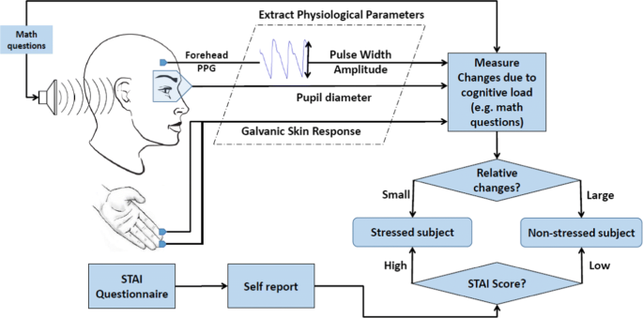
PROPOSED SYSTEM
We plan to design a real time face detection model. It is used to detect the stress levels using eyebrow contraction .Real time web cam feed is used to find the total stress values and whether it is ‘High Stress ’ or ‘Low stress’.

Slide 6
PROJECT DESCRIPTION
This is a real time face stress detection model. The model is image processing based model which is having two parts.
• Emotion Recognition
• Stress level calculation
The emotion recognition model will return the emotion predicted real time. The model classifies face as stressed and not stressed. A model is trained on the fer2013 dataset.
The stress level is calculated with the help of eyebrows contraction and displacement from the mean position. The distance between the left and right eyebrow is being calculated and then the stress level is calculated using exponential function and normalized between 1 to 100.

Slide 7
Module Description
The following modules are used in this project:
Keras: Deep learning library.
dlib: Toolkit for machine learning and computer vision.
imutils: Collection of convenience functions for OpenCV.
sklearn: Machine learning library (scikit-learn).
cv2: OpenCV library for computer vision.
matplotlib: Plotting library for creating visualizations.
numpy: Numerical computing library for arrays and matrices.
scipy: Scientific computing library.
load_and_process: Module for loading and processing data.
keras.preprocessing.image.img_to_array: Function for converting images to NumPy arrays in Keras.

Slide 8
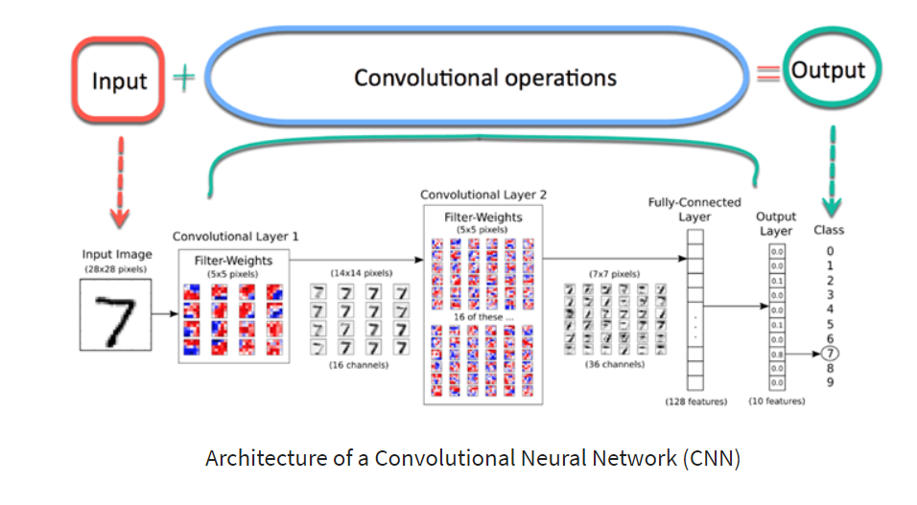
Algorithm
Start
Using a camera, capture the input image/object.
If the image/object is clear, it may be used as input, or it can be told to be rechecked.
After the input picture has been recognized, it displays the object/stress images in the form of emotions such as joyful, sad, furious, and so on.
Stop
CNNs (Convolutional Neural Networks) are specialized neural networks for visual data, employing convolutional and pooling layers to analyze spatial information. They excel in learning intricate patterns, making them pivotal in image recognition and analysis tasks.

Slide 9
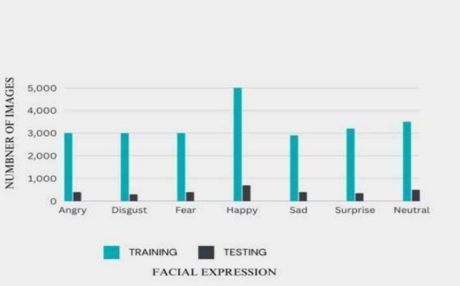
DATASET The dataset used in this project is taken from kaggle named FER2013. This data set having the 48 into 48 picture element grayscale frontal facial images of the human faces and it contains the different seven categories of emotions like angry or rage, disgust, afraid or fear, happy, surprise, sad, and neutral so in this data set we have around 28709 grayscale photos for the training phase and in the test phase we have around 3589 images .

Slide 10
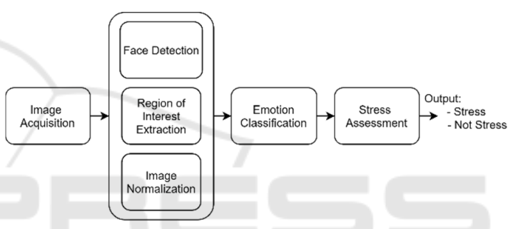
FlowChart
The system use case is to detect and notify the user that he shows signs of stress using facial expressions detected only with video images. The advantage of using video for personal stress detection is the easy accessibility to webcams when working with computers. The program will run in the background, monitoring the user's facial expressions, and will notify him/her when (s)he is showing signs of stress. In Figure 1 are presented the various modules composing the system.

Slide 11
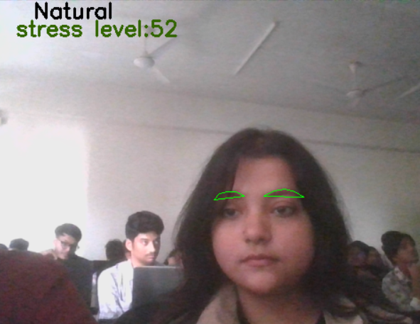
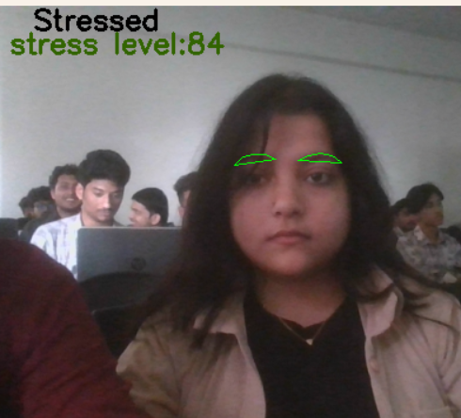
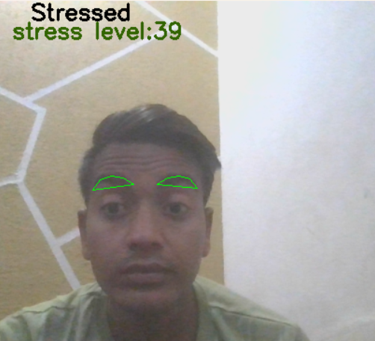
RESULTS In this study, we effectively display a person's diverse emotions by his shifting facial expressions and can determine the tension on his face from his expressions. We can use our classifier to live videos or streams. First create a virtual environment and it possess itsown dependencies. To recognise frontal faces in a video frame, a haar cascade classifier is utilised. This model may be utilised for existing videos or that have a live feed from a web camera. Below are some live feed results of our model .

Slide 12
CONCLUSION
The Tension Detection System monitors collected photographs of authorized users to forecast stress in workers, making the system safe. When the authenticated user logs in, the picture capture is done automatically depending on a time period. Based on certain common conversion and image processing processes, the acquired pictures are utilized to determine the user's stress. The system will then use Machine Learning algorithms to analyze the stress levels, resulting in more efficient outcomes.

Slide 13
Thank You!

